Slide 1
NEURALEARN
Every learning question becomes a guided lesson.
All-in-one AI learning mentor replaces scattered searching with instant, personalized understanding.
Notes:
Open with the problem and the promise in one frame. Neuralearn turns the scattered work of learning into a guided path, starting with the question a student already has.

Slide 2
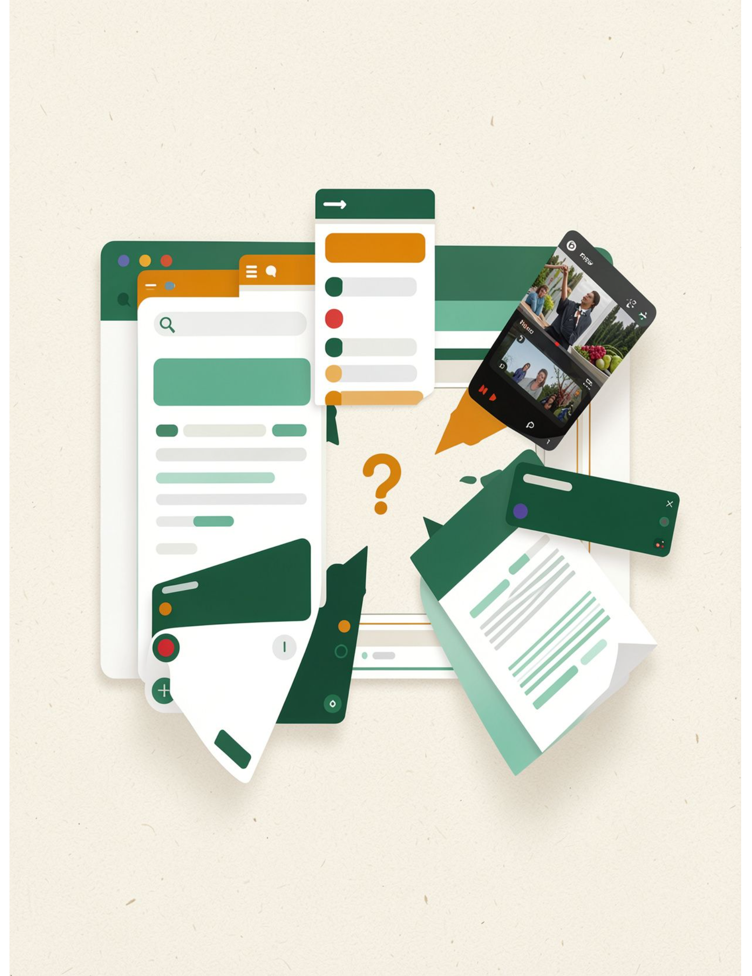
THE CURRENT WORKFLOW
Students do not need more tabs; they need one path to understanding.
01
Start with a small question
Then lose time searching YouTube.
02
Jump between tools
Google for context; ChatGPT for explanations; PDFs for source material.
03
Piece it together manually
Instead of learning in one continuous flow.
Notes:
Students are already assembling an answer from several products. The friction is not a lack of information. It is the loss of continuity between one step and the next.

Slide 3
THE PRODUCT LOOP
Neuralearn compresses the journey from prompt to understanding.
01
02
03
Ask naturally
Watch the lesson
Keep going
Start with the topic in your own words.
Get an instant AI-generated explainer video.
Read, ask follow-ups, and stay in context.
Notes:
The product compresses the distance between a question and a useful explanation. Students ask naturally, see the idea explained, then continue without rebuilding context in another tool.

Slide 4




ONE QUESTION, MANY WAYS IN
One question can become video, text, translation, and dialogue
Video
Text
It creates instant visuals based on the text output given by the AI.
Text-based explanations for clarity and review.
One prompt unlocks connected learning modes, powered by instant, topic-specific answers with low latency.
PDF uploads
Translation
PDF upload so course material becomes searchable and explainable.
Multilingual learning for more students and more subjects.
A live tutor answers follow-up doubts as the student learns.
Notes:
These are available today: video, text, multilingual support, and PDF uploads. The point is not a collection of features. It is one question becoming the format that helps this student move forward.

Slide 5
THE PERSONALIZATION FLYWHEEL
The product gets more personal as the student keeps learning.
Every follow-up adds context instead of starting over.
01
02
03
04
One-off answer
Contextual follow-up
Document-aware help
Learning history
Start with the question in front of you.
Ask the next question without resetting.
Bring course material into the conversation.
Meet the student where they are.
Notes:
The long-term advantage is continuity. Neuralearn can move from answering a single question to understanding the student's context, documents, follow-ups, and learning history.

Slide 6
NEXT PRODUCT FRONTIER
Neuralearn is becoming an AI mentor you can talk to.
Coming next: voice and video conversations where students speak naturally, the AI responds in real time, and the interaction feels closer to office hours than a search box.
Upcoming expansion · not yet shipped
Notes:
Make the distinction clear: voice and video are the upcoming expansion, not a shipped capability. The direction is a more natural interaction, closer to office hours than a search box.

Slide 7




THE OPPORTUNITY
The opportunity is a new default for academic help.
Start with instant topic understanding. Expand into a trusted learning layer.
1
Instant understanding
2
Subjects and languages
3
Documents and course context
4
Institutions and trusted learning support
Proof points to add when validated: user growth · retention · pilot evidence
Notes:
The wedge is simple: help a student understand a topic immediately. The expansion path is broader: subjects, languages, documents, and eventually institutional learning support. Add validated evidence here as it becomes available.

Slide 8
Fewer fragmented searches.
More moments of understanding.
NEURALEARN
Make learning feel immediate.
An always-available AI mentor for every learner.
For every question, one guided path forward.
Next step: partner with Neuralearn to shape the new default for academic help.
Notes:
Close on the change in behavior: fewer fragmented searches, more moments where the student understands. The ask is to partner with Neuralearn on making that guided path the default.

